Slide 1
Pascal’s Triangle
MS Number Theory’s…
PowerPoint Created By Nicholas Albanese

Slide 2
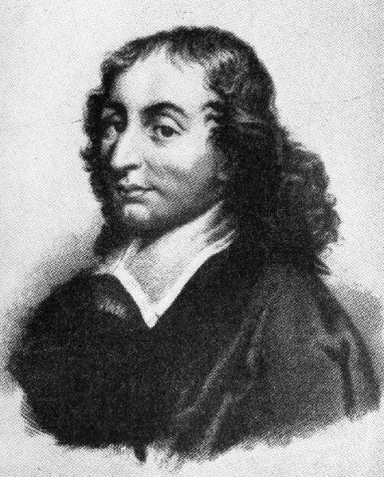
Blaise Pascal
He was born on June 19, 1623
He died on August 19, 1662
He created Pascal’s triangle
Wasn’t allowed to study mathematics before 15
Discovered triangles angles equal 180˚
His father let him do math after that
He invented the first digital calculator
Notes:
Blaise Pascal was born on June 19, 1623 and died on August 19, 1662 in Paris France.
Obviously, he created Pascal’s Triangle.
His father wouldn’t let Pascal study mathematics before he was 15, so he worked on math by himself.
One day, when he was 12, he discovered that a triangles angle measures equal two right angles, or 180⁰.
After his father saw what he accomplished, he let him study math.
Pascal eventually created the first digital calculator to help his father with his new job as a tax collector.

Slide 3
So How Does Pascal’s Triangle Work?
All you do is add the two numbers that are side-by-side to get the number below it!
Example:
4
6
10
Notes:
All you have to do is add the two numbers that are side-by-side to get the number below it.
In the example here, 4 and 6 are next to each other.
Notice how the number 10 is below them.
The sum of 4 and 6 is 10, therefore going on continuously forever.
You can also use this method to get from one row to the next.

Slide 4
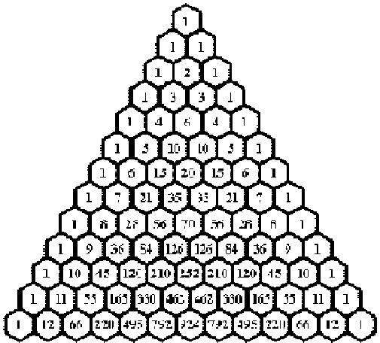
Diagonals
What’s a diagonal on the triangle?
How do you get from one diagonal to the next?
Notes:
This is just a short slide of what diagonals are so you could get a better understanding of the triangle.
Does anybody know what a diagonal on the triangle is?
This red line of numbers shows an example of what a diagonal is.
There are an infinite amount of diagonals, just like there are numbers.
You can go to the next diagonal, just like you can with rows.
And, if you have been paying attention to this presentation, I can guarantee that you already know how.
It’s the same way to go from one row to the next!
So let’s use the example with 4, 6, and 10 again.
You want to get to the next diagonal from 4, in this case we will use the 2nd diagonal.
Add 4 and 6 again to get 10 and now your at the 3rd diagonal! It’s that simple.

Slide 5
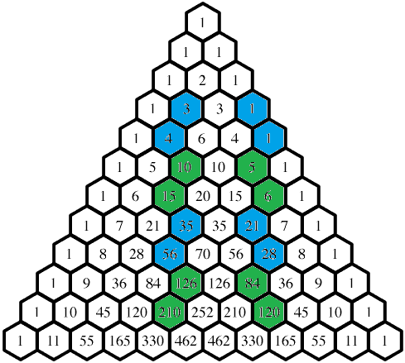
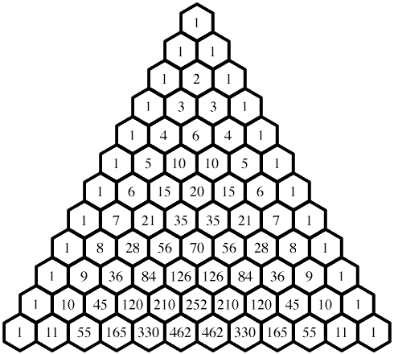
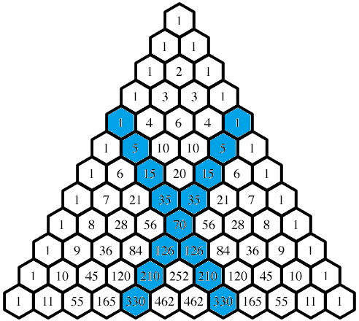
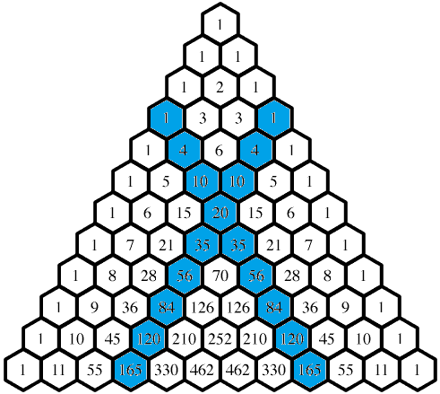
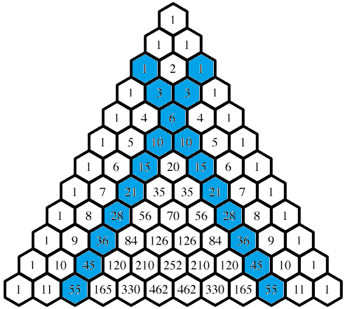
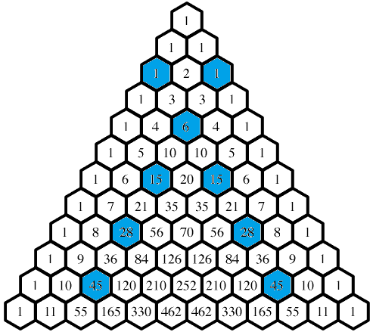
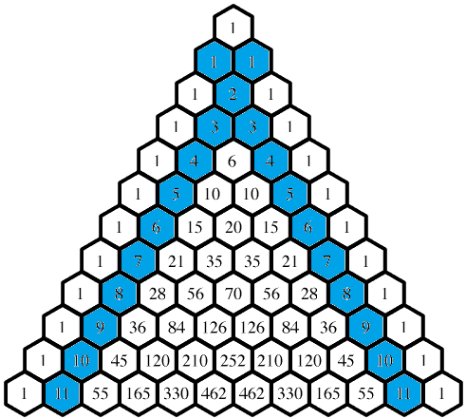
Finding Types of Numbers
Now that you know what diagonals are…
Find what diagonals these are in:
Natural numbers: 1, 2, 3, 4…
Pentatope numbers: 1, 5, 15, 35, 75…
Tetrahedral numbers: 1, 4, 10, 20…
Triangular numbers: 1, 3, 6, 10, 15…
Hexagonal numbers: 1, 6, 15, 28, 45…
CHALLENGE! Now see if you can find this:
How do you find the Catalan numbers (5, 14, 42, 132…)? This requires a lot of thinking.
7-2=5
25-11=14
91-49=42
336-204=132
Notes:
Now that you have better background knowledge of Pascal’s Triangle, let’s try to find some different types of numbers.
Does anybody know what diagonal the natural numbers are located? They’re located in the 2nd diagonal.
What about the pentatope numbers, like 1, 5, 15, 35, and 75? They’re located in the 5th diagonal.
What about the tetrahedral numbers, like 1, 4, 10, and 20? They’re located in the 4th diagonal.
Then there’s the triangular numbers, like 1, 3, 6, 10, and 15? They’re located in the 3rd diagonal.
And there is also the hexagonal numbers, like 1, 6, 15, 28, and 45? This is a little more difficult than the other problems. They are also in the 3rd diagonal, but they skip every other number.
Finally, there are the Catalan numbers, like 5, 14, 42, and 132.
This is the most challenging problem yet.

Slide 6
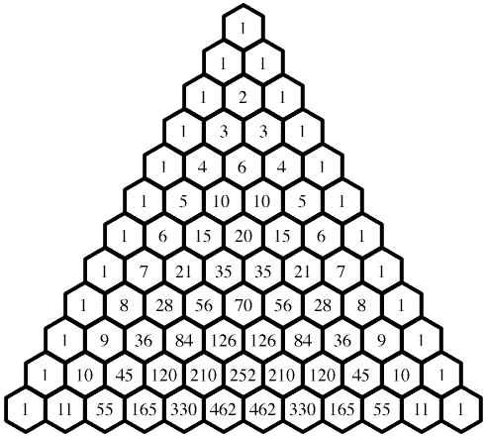
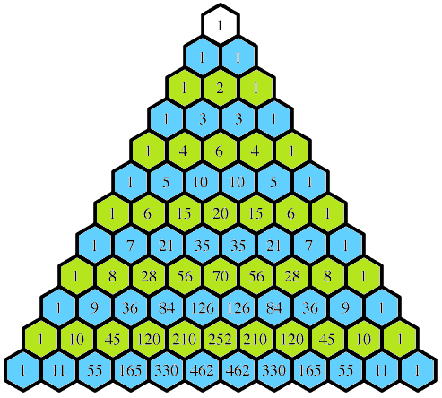
Patterns In Pascal’s Triangle
Can you predict the next row of numbers?
Powers of two: 2, 4, 8, 16, ...Look at the rows to see a pattern and figure it out.
Powers of eleven: 11, 121, 1331, 14641. Look at the big whole triangle going back to row 1. To see the pattern starting with row 1, then row 2 and row three.
1 and 1 combined make 11
1+1=2
1+2+1=4
1+3+3+1=8
1+4+6+4+1=16
1+5+10+10+5+1=32
And so on…
Notes:
Now that you are more familiar with Pascal’s triangle, let’s try to find some patterns.
So the first pattern that I want you to do is to predict the next rows of numbers. I showed an example earlier of how to get from one row to the next with 4, 6, and 10, so this shouldn’t be too hard. Does anyone want to volunteer?
Good. The next pattern here has to do with the powers of two, which are 2, 4, 8, 16, and so on. Look at the rows to see a pattern and figure it out. I’ll give you a hint—you have to add something to find one of the powers of two.
Great job. The next pattern we have to find is similar to the powers of two pattern that we just did. So now we have to find the powers of eleven, which are 11, 121, 1331, 14641, and so on. The pattern starts in row one, then row two, and on and on and on. Here’s another hint to make it a bit easier—you don’t have to add, subtract, multiply, or divide anything to get the powers of 11. Any volunteers?

Slide 7
Works Cited
https://courses.govhs.org/d2l/le/content/139164/viewContent/1544680/View
http://mathforum.org/workshops/usi/pascal/mo.pascal.html
Pascal's Triangle Questions.docx (My own work)
Pictures:
http://nevalalee.files.wordpress.com/2011/05/pascal.jpg
http://srikant.org/core/img390.png
http://mathforum.org/workshops/usi/pascal/images/base.gif

Slide 8
Thank You For Watching My Presentation!

